Slide 1
Nonlinear Equations in One Variable
Lecture-2
(The Secant Method
,Newton-Raphson Method )

Slide 2
Objective:
To find the root of a nonlinear equation in on variable with the help of secant methods and Newton-Raphson methods.

Slide 3
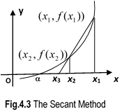
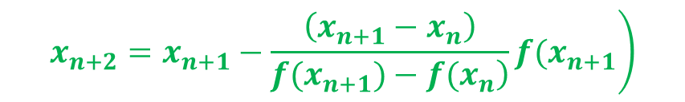
The Secant Method
In Secant method two values of x near the root is used and the root is approximated by the x-intercept of the secant line (chord) joining the two points.
Algorithm:
Step-1: Calculate the next estimated of the root from two initial guess using the following formula
$$\left.x_{n+2}=x_{n+1}−\frac{\left(x_{n+1}−x_{n}\right)}{\left.f(x_{n+1})−f(x_{n}\right)}f(x_{n+1}\right)$$
Step-2: In selecting, and care should be taken so that , is closer to the root than to get rapid convergence. This can be achieved by selecting and such that
Step-3: Repeat the process until , where is the specified accuracy.

Slide 4
Problems and Solutions
Example:
Find the root of$f\left(x\right)=\cos{x}+2\sin{x}+x^{2}$ using secant method initiating with $x_{1}=0 andx_{2}=−0.1$ with tolerancy/accuracy$ε=0.001$
Solution:

Slide 5
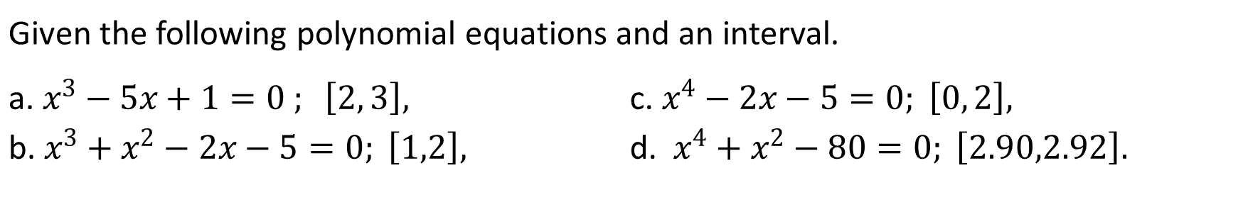
Exercise
Given the following polynomial equations and an interval.
a. $x^{3}−5x+1=0 ; \left[2, 3\right],$ b. $x^{3}+x^{2}−2x−5=0; \left[1,2\right],$ | c. $x^{4}−2x−5=0; \left[0, 2\right],$ d. $x^{4}+x^{2}−80=0; \left[2.90,2.92\right].$
Apply secant method to estimate the root correct to 2 d.p. in the last interval acquired by using bisection method.

Slide 6
Advantages and Drawbacks: The secant Method
Advantages:
It converges faster.
Drawbacks:
Division by zero.
Root jumping.

Slide 7
Outcome
By applying Secant method, nonlinear equations in one variable can be solved to find roots (approximately) of the equation, And it converges faster than bisection method,although it has few drawbacks.

Slide 8
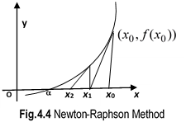
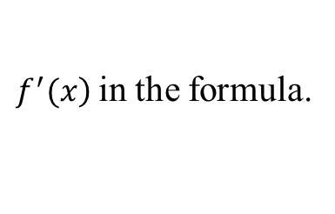
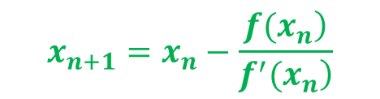
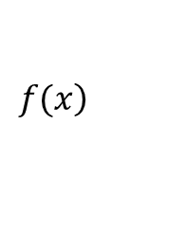
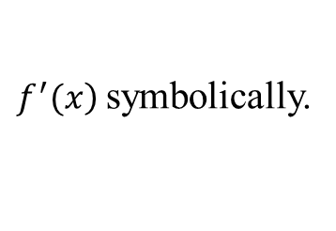

Newton-Raphson Method
In this method, the root of the equation is approximated by the x-intercept of the tangent line through a guess value .Newton-Raphson formula can be written as follows
$$x_{n+1}=x_{n}−\frac{\left.f(x_{n}\right)}{\left.f^{′}(x_{n}\right)}$$
$$, n=0, 1, 2, 3, ⋅ ⋅ ⋅$$
Algorithm:
Step-1: Calculate
$\left.f^{′}(x\right)$ symbolically.
Step-2: Substitute and
$$\left.f(x\right)$$
$\left.f^{′}(x\right)$ in the formula.
Step-3: Choose a suitable starting value for
Step-4: Repeat the process until , where is the specified accuracy.

Slide 9

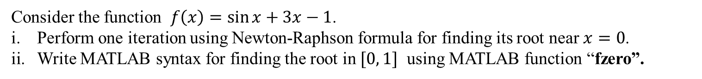
Problems and Solutions
Example:
Consider the function $f\left(x\right)=\sin{x+3x−1}$.
Perform one iteration using Newton-Raphson formula for finding its root near $x=0$.
Write MATLAB syntax for finding the root in $[0, 1]$ using MATLAB function “fzero”.
Solution:
i. $f\left(x\right)=\sin{x+3x−1}$
$f^{′}\left(x\right)=\cos{x+3}$
$f\left(0\right)=−1, f^{′}\left(0\right)=4$
$x_{1}=0−\frac{−1}{4}=0.25$
ii. MATLAB code:
>> F=@(x) sin(x)+3*x-1; handle
>> Sol = fzero(F, [0,1])
Sol =
0.2507

Slide 10
Exercise
Given the following polynomial equations and an interval.
a. $x^{3}−5x+1=0 ; \left[2, 3\right],$ b. $x^{3}+x^{2}−2x−5=0; \left[1,2\right],$ | c. $x^{4}−2x−5=0; \left[0, 2\right],$ d. $x^{4}+x^{2}−80=0; \left[2.90,2.92\right].$
Write down an iteration formula based on Newton-Raphson method.
Perform one iteration starting using the above formula with a suitable value in the given interval to estimate the root to 2 d.p.
Write down MATLAB codes to execute the iteration four times.

Slide 11
Advantages and Drawbacks: Newton-Raphson Method
Advantages:
It converges faster.
Requires only one guess.
Drawbacks:
Division by zero.
Root jumping.
Inflection point issue.

Slide 12
Outcome
By applying Newton-Raphson method, nonlinear equations in one variable can be solved to find roots (approximately) of the equation, although it has few drawbacks.

Slide 13

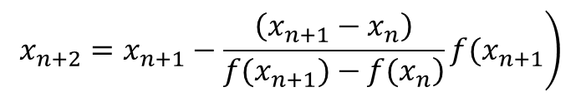








1. What is the formula to find the root of the polynomial by Secant method?
$$x_{n+1}=\frac{a_{n}+b_{n}}{2}$$
$$\left.x_{n+2}=x_{n+1}−\frac{\left(x_{n+1}−x_{n}\right)}{\left.f(x_{n+1})−f(x_{n}\right)}f(x_{n+1}\right)$$
$$x_{1}=x_{0}−\frac{\left.f(x_{0}\right)}{\left.f^{′}(x_{0}\right)}$$
a) , b) , c) ,d) Neither
2. The next iterative value of the root of
$$x^{2}−4=0 \text{using} \text{secant} \text{method}\text{, }\text{if} \text{the} \text{initial} \text{guesses}$$
are 3 and 4, is-
a) 2.2857 , b) 2.5000 , c) 5.5000 , d) 5.7143
3. What is the formula to find the root of the polynomial by Newton-Raphson method?
$$x_{1}=x_{0}−\frac{\left.f(x_{0}\right)}{\left.f^{′}(x_{0}\right)}$$
$$x_{n+1}=\frac{a_{n}+b_{n}}{2}$$
a) , b) , c) d) Neither
$\left.y−f(x_{0})=f^{′}(x_{0}) (x−x_{0}\right)$
4. What is the derivative of the function
$$f\left(x\right)=2cos3x+2−x ?$$
a) ,b) , c) d) Neither
$$f^{′}(x)=−6sin3x−1$$
$$f^{′}(x)=−4sin2x−1$$
$$f^{′}(x)=−sin2x−1$$

Slide 14
5. The next iterative value of the root of
$$x^{2}−4=0 \text{using} \text{Newton} \text{Raphson} \text{method}\text{, }\text{if} \text{the} \text{initial} \text{guess} \text{is}\text{ 3, }\text{is}\text{−}$$
a) 2.166 , b) 2.5000 , c) 5.5000 , d) 5.7143

